Slide 1
What are R-DeePs and how do we test them?
Proteins where the interactome depends on RNA!
Rnase
Change in RNA-interactions lead to change in data.

Slide 2
Demension reduction analysis - PCA and UMAP

Slide 3
Developing a linear regression model – real shift

Slide 4
Developing a linear regression model – absolute shift

Slide 5

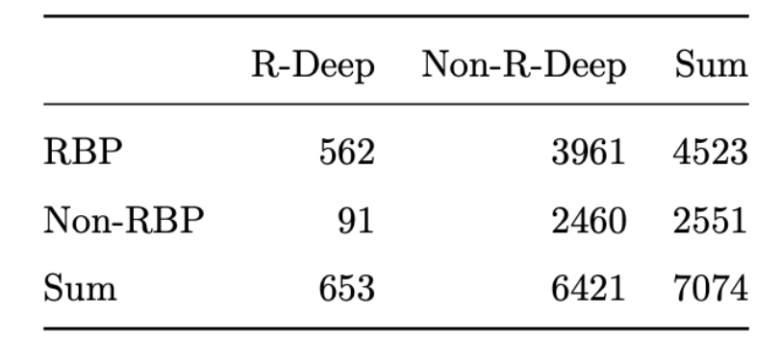
Comparison with given databases
RNA-dependent proteins
RNA-independent proteins

